Slide 1
Problems in multithreading
Deadlock : May occur when 2 or more process trying to get the same resources at same time
Example : Single road bridge two truck arrived at opposite direction
User Phone1 and User Phone2 dialing at same time (busy indefinitely)
P1 P2
taken S1 S2 taken
waiting S2 S1 waiting

Slide 2
Problems in multithreading
Starvation : Indefinite blocking
A process may never be removal from Semaphore queue in which it is suspended
Priority Inversion
Scheduling problem
When Low priority process holds a lock needed by higher priority process
It can solved via priority – inheritance protocol.

Slide 3
Threads Synchronization
When to use which Construct
Use Case
Following Construct are :
Count Down Latch
Semaphore
Cyclic Barrier
Phaser
Exchanger

Slide 4
Count Down Latch
A SERVER - where the main task can only start when all the required services have started
Example : GCD (Greatest Common Divisor) algorithm
GCD of 8 & 12 = 4
Online Food ordering (tracking the processing of food and notify customer when ready).

Slide 5
M1
M2
M3
T1
T2
T3
Obj
=new CountDownLatch(3)
Get data from 3 different Rest Service (Micro service) and wants to wait from all the 3 services are ready (count down latch)
3 threads has ref of same count down latch obj.
T4
Obj.CountDown();
// decrement, when count becomes zero (like 2->1->0), it will notify
T5
Obj.await(); // causes current thread to wait until the latch has counted down to zero
// if current count is zero then this method returns immediately.
getCount() // returns pending Count Launch

Slide 6
Count Down Latch
Count Down Latch is a high level Sync utility which is used to prevent a particular thread to start processing until all other threads are ready.
Multithreaded testing
One thread needs to wait for other threads before they start processing.

Slide 7
MAIN THREAD
LATCH COUNT =2
LATCH COUNT =1
LATCH COUNT =0
Task to Perform

Slide 8
CountDownLatch
CountDownLatch(int)
await():void
Await(long,TimeUnite):Boolean
CountDown():void
getCount():long
toString()
It is a kind of Synchronizer
It makes one thread to wait until other threads have finished their jobs.

Slide 9

Semaphore
Proposed by Dijkstra’s in 1965, to solve critical section problem
To achieve Process Synchronization in multiprocessing environment
Manage Concurrent process by using Single integer value.
Variable (non-negative) & shared between threads.
Two types :
Binary -> Mutex lock (0,1)
Counting -> Unrestricted - to +

Slide 10
Algorithm
P1
P2
P3
function V(semaphore S, integer I):
[S ← S + I]
function P(semaphore S, integer I):
repeat:
[if S ≥ I:
S ← S − I
break]
Entry Section
CS
Exit Section
P() : Down, Wait
V() up Signal post release

Slide 11
Algorithm
Two atomic operation Wait and Signal (All or Non Success)
Wait(S) : While S<=0 do no operation
S:=S-1
Signal(S) : S=S+1 do some operation (S is positive and non zero)

Slide 12
Algorithm
repeat
wait(mutex)
Critical Section Entry Section
signal(mutex)
reminder section Exit Section
Until false
Hint : mutex is mutual exclusive

Slide 13
Example
Mutex =0
Washing process P1 -> Statement 1, Signal (mutex)
Drying process of clothes P2-> wait(mutex), Statement 2

Slide 14
Example :
Po Intial
mutex =0
wait(0) -> do no operation
Signal -> (S=S+1)
P1 mutex=1
wait(1) -> enters to critical section
mutex reset to Zero

Slide 15
Semaphore
Semaphore is an integer variable which is used in mutual exclusive manner by various Concurrent cooperative process in order to achieve Synchronization.
Traffic signal to avoid clash
Semaphore is used in railways
One rail track can serve multiple train but only one can be used at a time.
Wait and signal in proper order to avoid dead lock
Machine independent
Prevent race condition
Prevent loss of data

Slide 16
Disadvantage
Priority inversion
Loss of modularity
One process enter to critical section, problem to ensure sync

Slide 17
Semaphore
I love India
P1
1
2
Display
4
P2
3
I love India very much

Slide 18

Semaphore
Acquire (value=0)
Printer
Release(value=1)
Object
One Shared resource
Lock based approach
Many resources
Mutex
Signal approach (integer)

Slide 19
Phaser
Allows a variable (or fixed) # of threads to wait for all operation performed in other threads to complete before proceeding.
Example : One human known use is different work crews with different #’s of working coordination to build a house
Well suited for variable –size “cyclic”, “entry” or exit barriers.
#party can vary dynamically
register()
bulkRegister(int)
arriveAndDeregister()
1
3
2

Slide 20
Exchanger
Producer directly gives to consumer without storing in Queue
Producer Thread
Consumer Thread
Empty
put
take
Single item
Synchronous Queue
Empty
Direct handoff
Blocking Queue of size 1
Space for Single element

Slide 21
T1
T2
Single item Vice versa
Exchanger on T1 and T2
Direct handoff
Giving and Getting is exchange
Empty

Slide 22
T2
B
Exchange
X
Blocking, T1 is not ready
Exchanger
X
Exchange
Exchanger

Slide 23
Use Case : Producer and Consumer exchange full and empty buffer
T1
T2
T1
T2
Empty
Empty
Empty
Full Buffer
Empty
Full Buffer
Diagram : 2
Diagram : 1

Slide 24
Cyclic Barrier
Cyclic Barrier is synchronized aid which allows set of threads to wait for each other at common barrier points.
It is called cyclic because it can be reused once waiting threads are released.
Let's say you have 3 threads, you want all threads(terms as parties) to reach a common point and then only they should proceed ahead.
In this case, you can use Cyclic Barrier with 3 parties and once 3 threads reach a common point, you can call an event which will implement runnable interface and three threads will be released

Slide 25
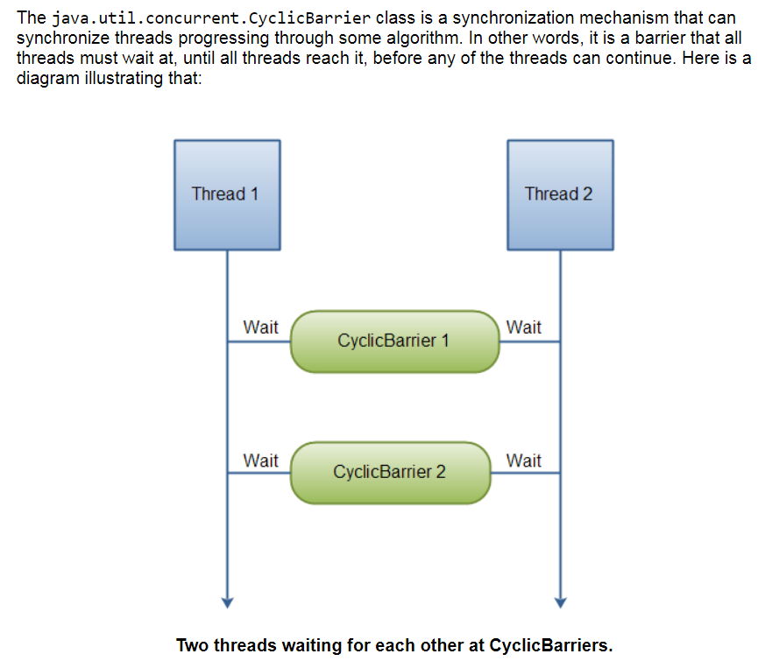

Slide 26
Difference between cyclic and count down latch
You can reuse the barrier even after its broken (Cyclic), not possible at count down latch once count reaches to Zero.

Slide 27
Volatile
Volatile is used to solve filed visibility problem
public class volatileVisibility{
volatile int x=0;
public void writerThread(){
x=1;
}
public void readThread(){
int r2=x;
}
Writer Thread
Reader Thread
Core1 | Core2
L1Cache | L1Cache
X=1
X=0 it change to1
X=1
R2=1
X=0 it
Change to 1
Shared Cache
load

Slide 28
Ideal thread count
Ideal Thread count = No. of Cores X ( 1 + (Wait time/ CPU time)
Other factors :
other applications running on CPU
Thread size may be 1 to 2 MB
Executor Service running on same JVM
Time taken for Switching
Data Locality (L1/L2 …. flushed during switch).

